Slide 1
Project OSMAE
A way towards a green future

Slide 2
Objective
to condense humidity from the atmosphere at feasible environment
to auto irrigate the interior plant decors , thus help to sustain a green building
To produce water from atmosphere moisture where the terrain does not support for rainfall
Aravalli ranges in Rajasthan has relatively higher humidity and lower temperature at nights but lower rainfall.
Thus an upscale model of this project could be used to sustain the population around the area.

Slide 3
Components
Microcontroller
Arduino nano
Realy modules
LCD Display
Humidity sensor
Moisture sensor
Temperature sensor
Peltier setup

Slide 4
Tech stack
Front End Back End
Arduino based C++ Arduino based C++
by LCD display with Sensors

Slide 5
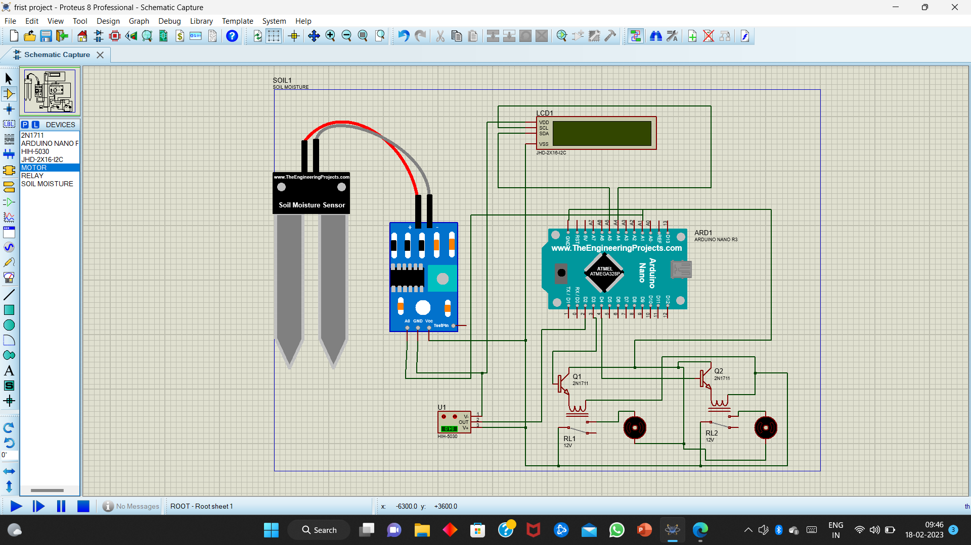
Model Circuit

Slide 6
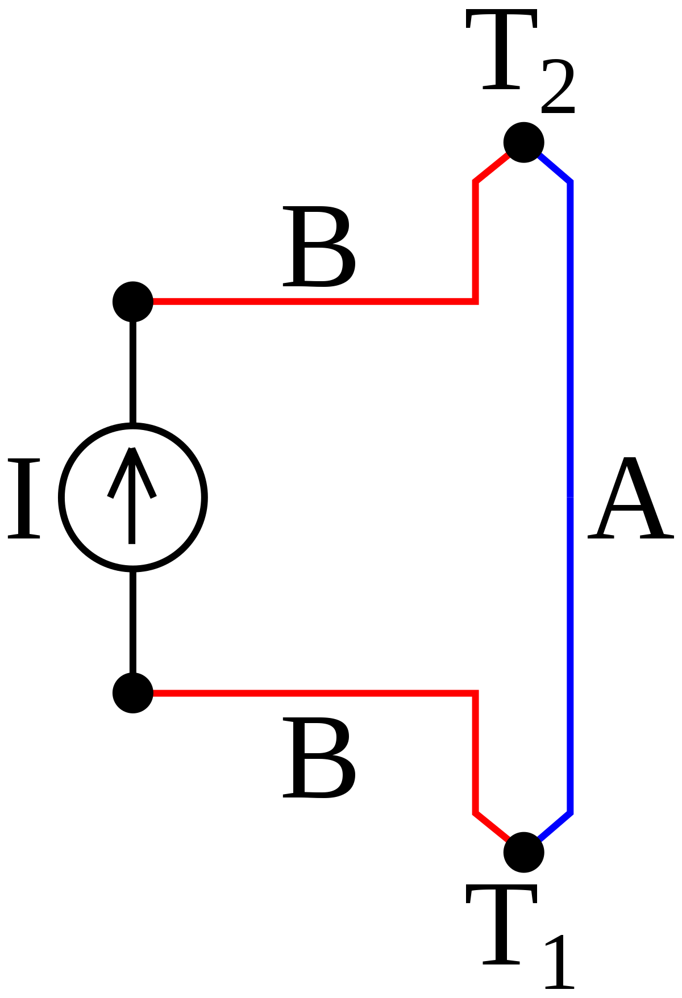
Peltier effect
When electric current is passed through two dissimilar metals, heat is produced at one of the junctions between two metals and heat is removed from the other junction.

Slide 7
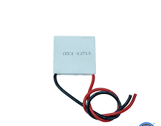
Peltier modules
It employs peltier effect to produce heat at one face and remove heat from the other surface.

Slide 8
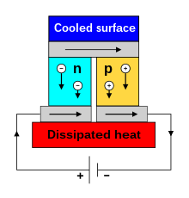
Semiconductor Peltier Modules
*It consists of p-type and n-type semiconductors connected in series.
*Electrons and holes transfer heat from one side to another.
*This results in heating up of one side and cooling of the other.

Slide 9
THANK YOU

